Slide 1
CSC 220: Week 4

Slide 2
Learning objectives
Learn the principles basic visualizations and when to use them.
Implement what we learn on the Monkeypox data set.

Slide 3
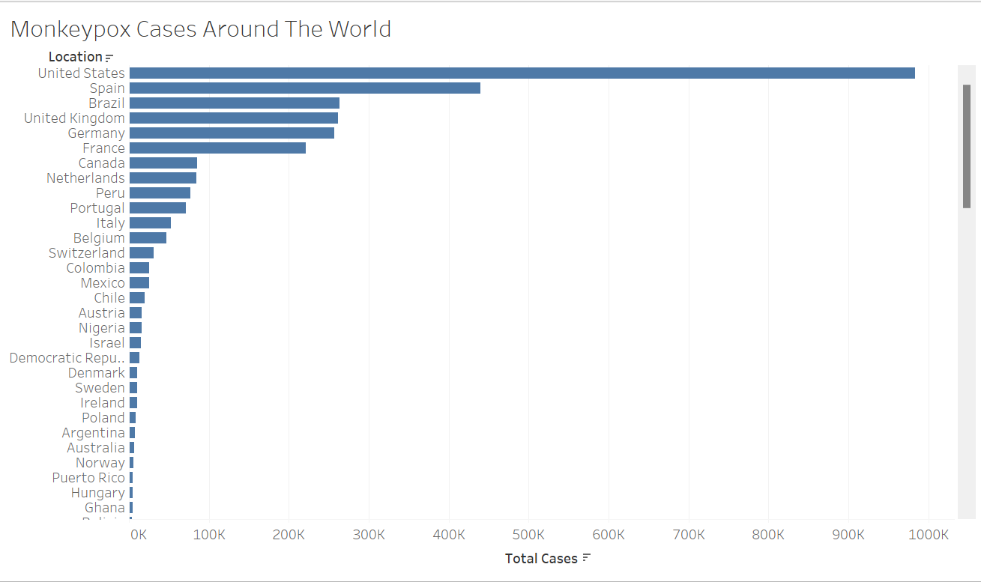
Bar graphs
Bar graphs are used to compare things between different groups or to track changes over time.
For example, we previously used bar graphs to compare the number of monkeypox cases between countries.

Slide 4
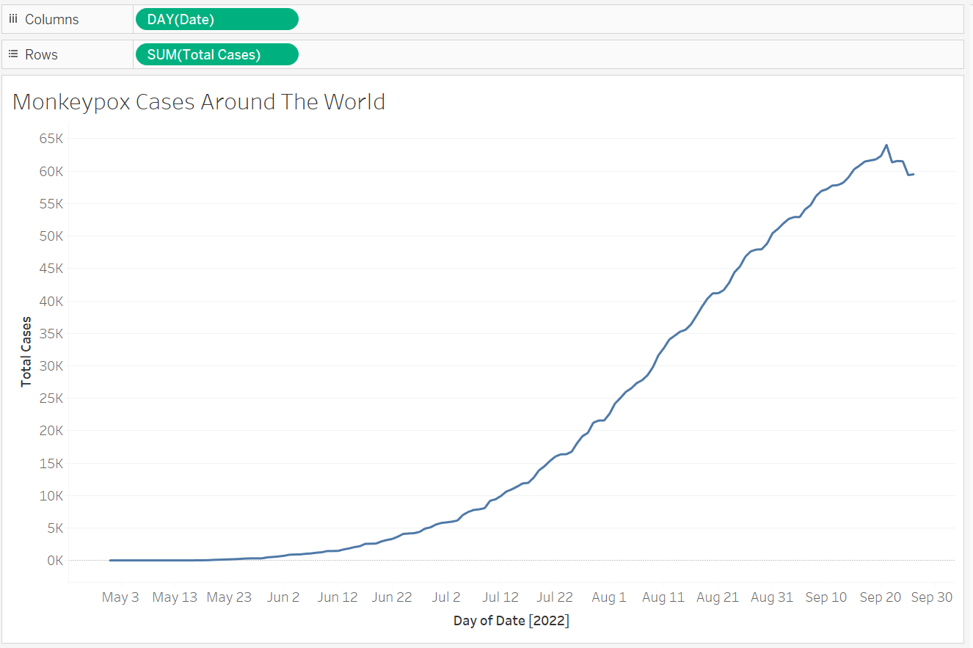
Lines
Line graphs are used to track changes over short and long periods of time.
For example, we created time series graphs to track the progress of Monkeypox over this year.

Slide 5
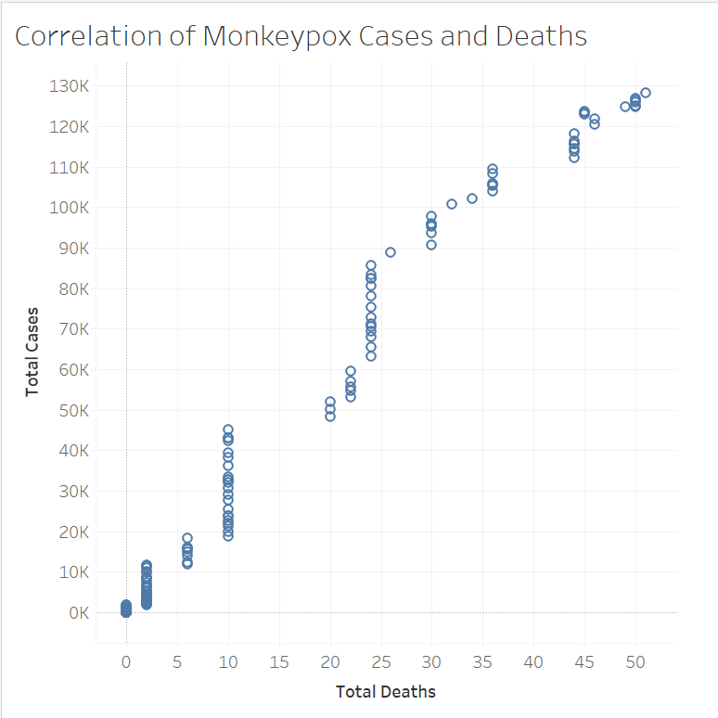
Scatter Plots
Scatter plots are used to show relationships. It shows the strength of the linear relationship between two variables.
Correlation ≠ Causation!
For example, we can examine the correlation between Confirmed Monkeypox Cases and Deaths over time.

Slide 6
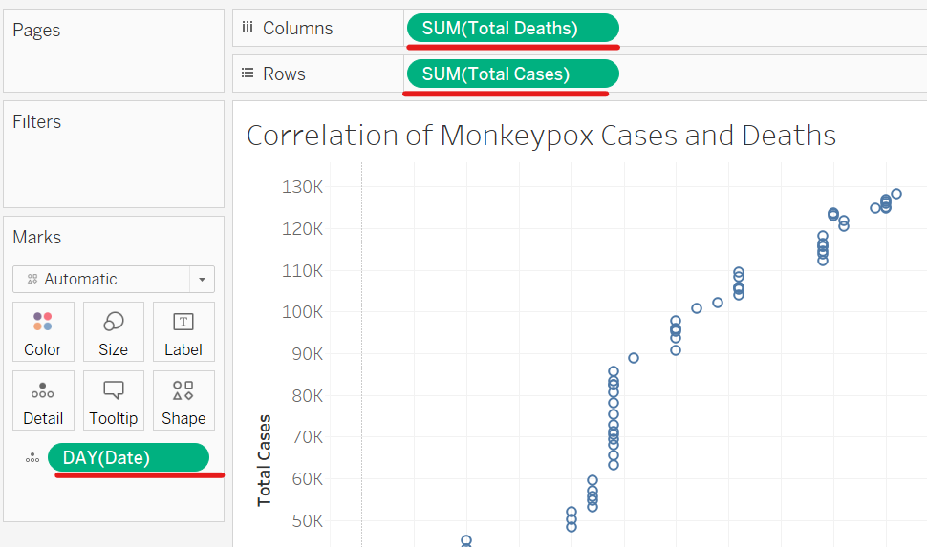
Scatter Plots in Tableau
Plot the Sum of Total Deaths vs. the Sum of Total Cases each day.
Use Date(day) for Detail, which is defined by the dimensions you use to segment your measures.
We see that as the number of cases increases, the death total also increases.
* We can add a trend line from Analytics!

Slide 7
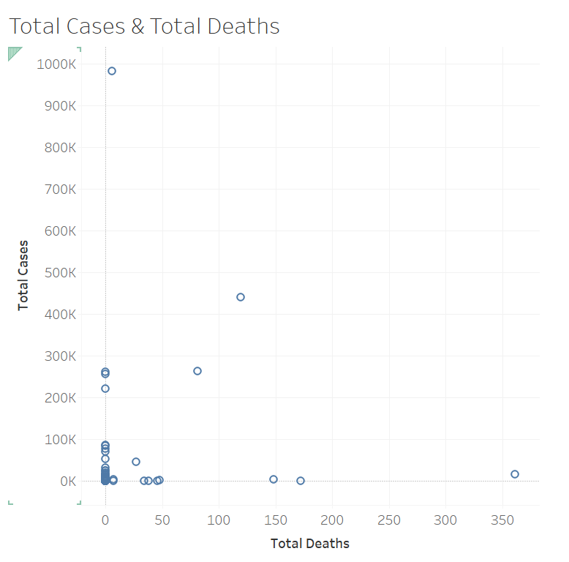
Scatter Plots in Tableau
We can also detect counties that are outliers by using Location for Detail.
What are the outliers in this graph?

Slide 8
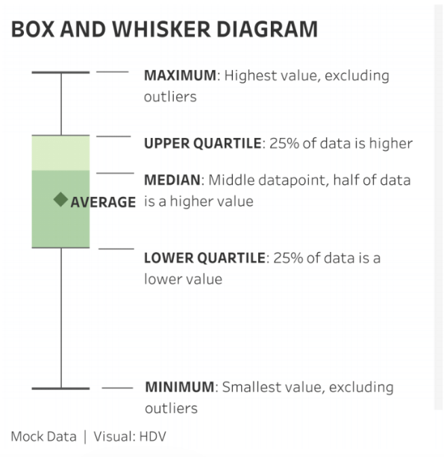
Box Plots
Box plots are used to show distributions of numeric data values, especially when you want to compare them between multiple groups.
For example, we can use it to detect countries with unusual numbers of new Monkeypox cases.

Slide 9
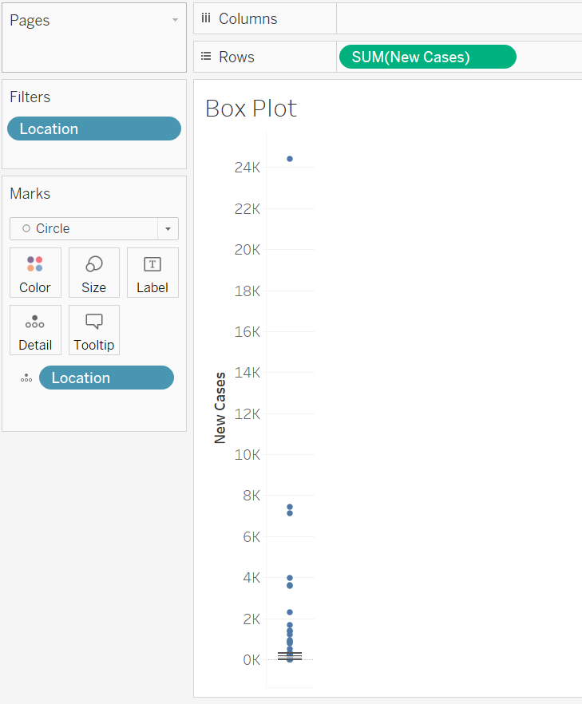
Box Plots in Tableau
Drop Sum of New Cases in Rows.
Use Location for Detail,
Chose a Box plot from show me in on the right.
Exclude World from the plot.
We find the U.S. to be an extreme outlier.

Slide 10
Thank you!

